Slide 1

HFW and LSR WW - Mixed Influent feasibility study
Sept 2022

Slide 2
Agenda
Discussion on the various simulations
Case 1: 1500 mg/l of Fluoride, 150 m3/hr of HFW, 250 m3/hr of LSR A2
Case 2: 500 mg/l of Fluoride, 150 m3/hr of HFW, 250 m3/hr of LSR A2
Case 3: 500 mg/l of Fluoride, 190 m3/hr of HFW, 210 m3/hr of LSR A2
Case 4: 500 mg/l of Fluoride, 150 m3/hr of HFW, 150 m3/hr of LSR A2
Case 5: 500 mg/l of Fluoride, 150 m3/hr of HFW, 200 m3/hr of LSR A2
Next steps

Slide 3
HFW and LSR A2 mixed Influent WW chemistry Case 1
S/N | Parameters | Units | HFW | LSR A2 | Combined Wastewater
1 | Flow | m3/h | 150.0 | 250.0 | 400.0
2 | pH | - |  | 7 - 9 | 7*
3 | Sodium | mg/ℓ | 750.00 | 262.3 | 445.2
4 | Potassium | mg/ℓ |  | 1.0 | 0.6
4 | Magnesium | mg/ℓ |  | 1.0 | 0.6
5 | Calcium | mg/ℓ |  | 1.0 | 0.6
6 | Nitrate | mg/ℓ |  | 10.0 | 6.3
6 | Carbonate | mg/ℓ |  | 12.0 | 7.5
7 | Bicarbonate | mg/ℓ |  | 108.3 | 67.7
7 | Chloride | mg/ℓ | 250.00 | 50.0 | 125.0
8 | Sulphate | mg/ℓ |  | 1.0 | 0.6
9 | Silica | mg/ℓ |  | 100.0 | 62.5
12 | TDS | mg/ℓ | 1000 |  | 375.0
13 | Fluoride | mg/ℓ | 1500.0 | 200.0 | 687.5
14 | TSS | mg/ℓ | 1000.0 | 200.0 | 500.0
14 | NH4 | mg/ℓ |  | 100.0 | 62.5
15 | Phosphate | mg/ℓ | 50.0 |  | 18.8
*Assumed to be neutral Ph. This will be confirmed after collecting few samples
Notes:
210 m3/hr – LSR
190 M3/HR - HFW

Slide 4
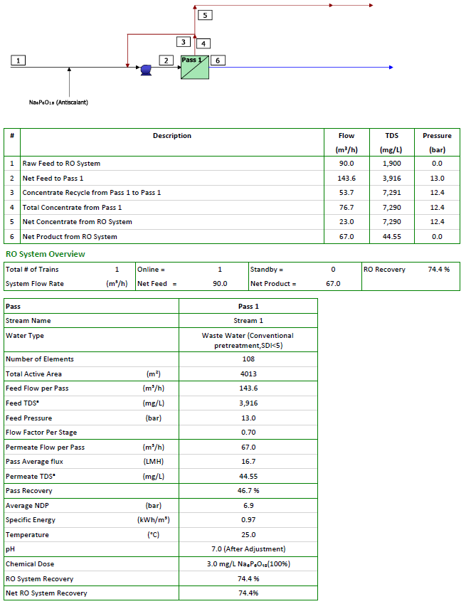
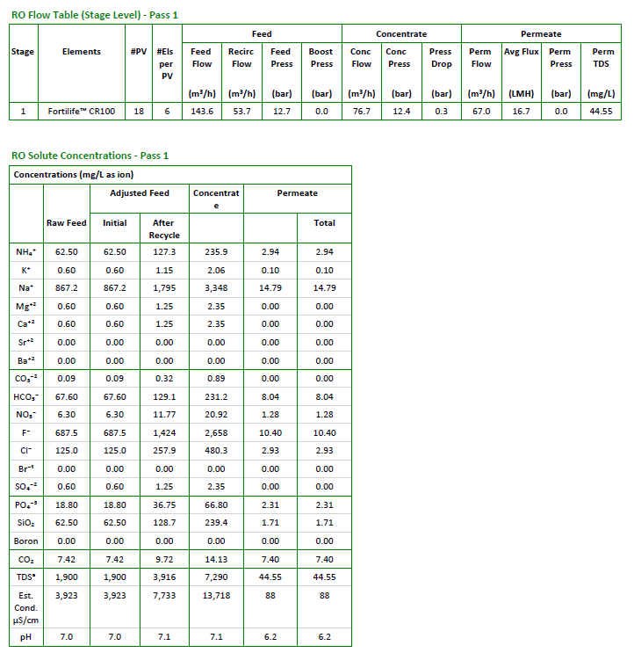
Case 1: ROi Projections - Mixed Influent CR100 and 75% recovery

Slide 5
HFW and LSR mixed Influent WW chemistry Case 2
S/N | Parameters | Units | HFW | LSR A2 | Combined Wastewater
1 | Flow | m3/h | 150.0 | 250.0 | 400.0
2 | pH | - |  | 7 - 9 | 7*
3 | Sodium | mg/ℓ | 750.00 | 262.3 | 445.2
4 | Potassium | mg/ℓ |  | 1.0 | 0.6
4 | Magnesium | mg/ℓ |  | 1.0 | 0.6
5 | Calcium | mg/ℓ |  | 1.0 | 0.6
6 | Nitrate | mg/ℓ |  | 10.0 | 6.3
6 | Carbonate | mg/ℓ |  | 12.0 | 7.5
7 | Bicarbonate | mg/ℓ |  | 108.3 | 67.7
7 | Chloride | mg/ℓ | 250.00 | 50.0 | 125.0
8 | Sulphate | mg/ℓ |  | 1.0 | 0.6
9 | Silica | mg/ℓ |  | 100.0 | 62.5
12 | TDS | mg/ℓ | 1000 |  | 375.0
13 | Fluoride | mg/ℓ | 500.0 | 200.0 | 312.5
14 | TSS | mg/ℓ | 1000.0 | 200.0 | 500.0
14 | NH4 | mg/ℓ |  | 100.0 | 62.5
15 | Phosphate | mg/ℓ | 50.0 |  | 18.8
*Assumed to be neutral Ph. This will be confirmed after collecting few samples
Notes:
210 m3/hr – LSR
190 M3/HR - HFW

Slide 6
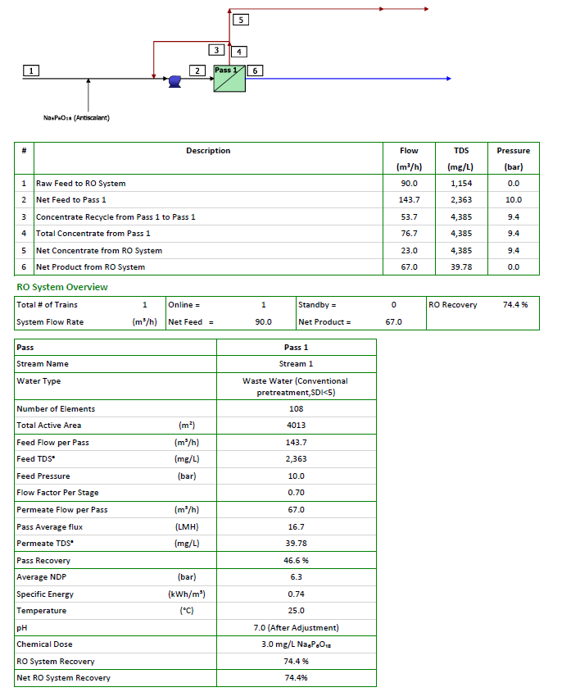
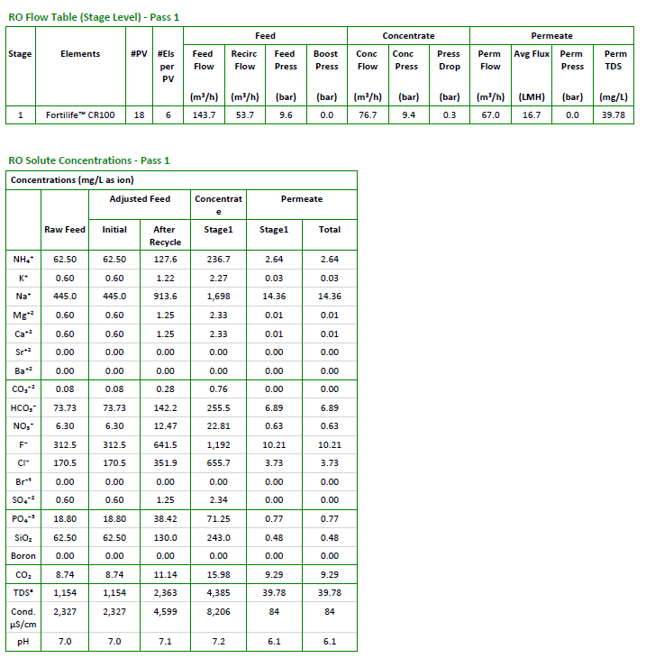
Case 2: ROi Projections - Mixed Influent CR100 at 75% Recovery

Slide 7
HFW and LSR mixed Influent WW chemistry Case 3
S/N | Parameters | Units | HFW | LSR A2 | Combined Wastewater
1 | Flow | m3/h | 190.0 | 210.0 | 400.0
2 | pH | - |  | 7 - 9 | 7*
3 | Sodium | mg/ℓ | 750.00 | 262.3 | 494.0
4 | Potassium | mg/ℓ |  | 1.0 | 0.5
4 | Magnesium | mg/ℓ |  | 1.0 | 0.5
5 | Calcium | mg/ℓ |  | 1.0 | 0.5
6 | Nitrate | mg/ℓ |  | 10.0 | 5.3
6 | Carbonate | mg/ℓ |  | 12.0 | 6.3
7 | Bicarbonate | mg/ℓ |  | 108.3 | 56.9
7 | Chloride | mg/ℓ | 250.00 | 50.0 | 145.0
8 | Sulphate | mg/ℓ |  | 1.0 | 0.5
9 | Silica | mg/ℓ |  | 100.0 | 52.5
12 | TDS | mg/ℓ | 1000 |  | 475.0
13 | Fluoride | mg/ℓ | 500.0 | 200.0 | 342.5
14 | TSS | mg/ℓ | 1000.0 | 200.0 | 580.0
14 | NH4 | mg/ℓ |  | 100.0 | 52.5
15 | Phosphate | mg/ℓ | 50.0 |  | 23.8
*Assumed to be neutral Ph. This will be confirmed after collecting few samples
Notes:
210 m3/hr – LSR
190 M3/HR - HFW

Slide 8
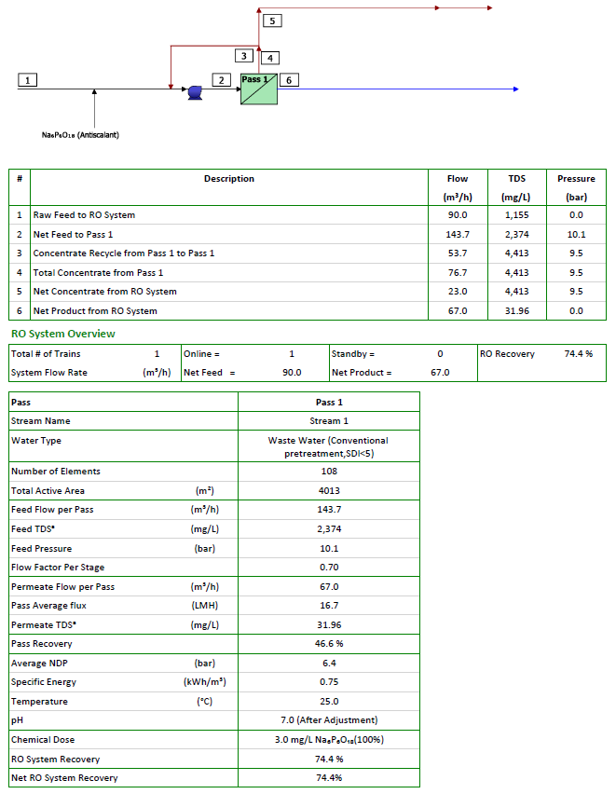
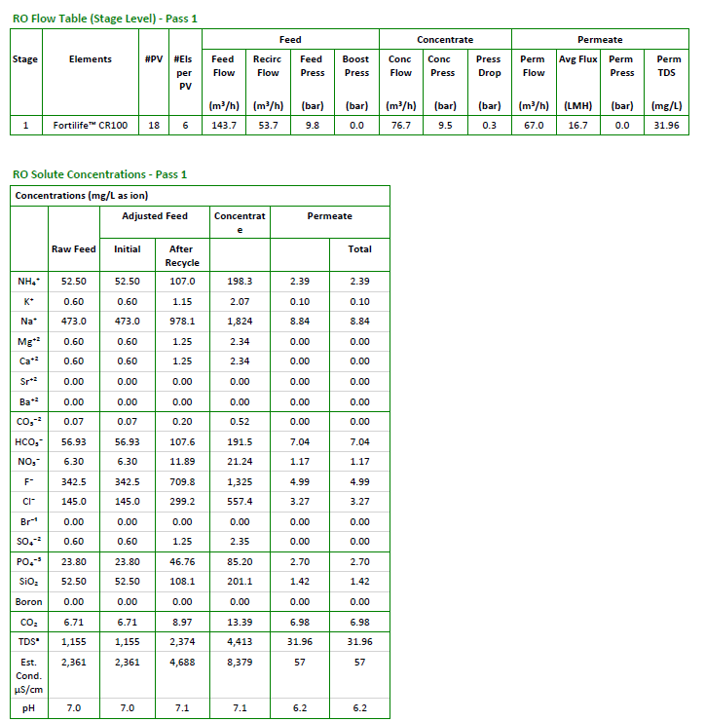
Case 3: ROi Projections - Mixed Influent CR100 at 75% Recovery

Slide 9
HFW and LSR Mixed Influent WW chemistry Case 4
S/N | Parameters | Units | HFW | LSR A2 | Combined Wastewater
1 | Flow | m3/h | 150.0 | 150.0 | 300.0
2 | pH | - |  | 7 - 9 | 7*
3 | Sodium | mg/ℓ | 750.00 | 262.3 | 506.2
4 | Potassium | mg/ℓ |  | 1.0 | 0.5
4 | Magnesium | mg/ℓ |  | 1.0 | 0.5
5 | Calcium | mg/ℓ |  | 1.0 | 0.5
6 | Nitrate | mg/ℓ |  | 10.0 | 5.0
6 | Carbonate | mg/ℓ |  | 12.0 | 6.0
7 | Bicarbonate | mg/ℓ |  | 108.3 | 54.2
7 | Chloride | mg/ℓ | 250.00 | 50.0 | 150.0
8 | Sulphate | mg/ℓ |  | 1.0 | 0.5
9 | Silica | mg/ℓ |  | 100.0 | 50.0
12 | TDS | mg/ℓ | 1000 |  | 500.0
13 | Fluoride | mg/ℓ | 500.0 | 200.0 | 350.0
14 | TSS | mg/ℓ | 1000.0 | 200.0 | 600.0
14 | NH4 | mg/ℓ |  | 100.0 | 50.0
15 | Phosphate | mg/ℓ | 50.0 |  | 25.0
*Assumed to be neutral Ph. This will be confirmed after collecting few samples
Notes:
210 m3/hr – LSR
190 M3/HR - HFW

Slide 10
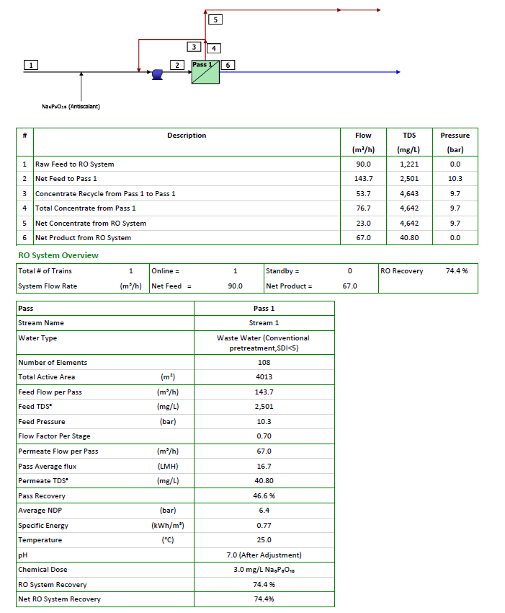
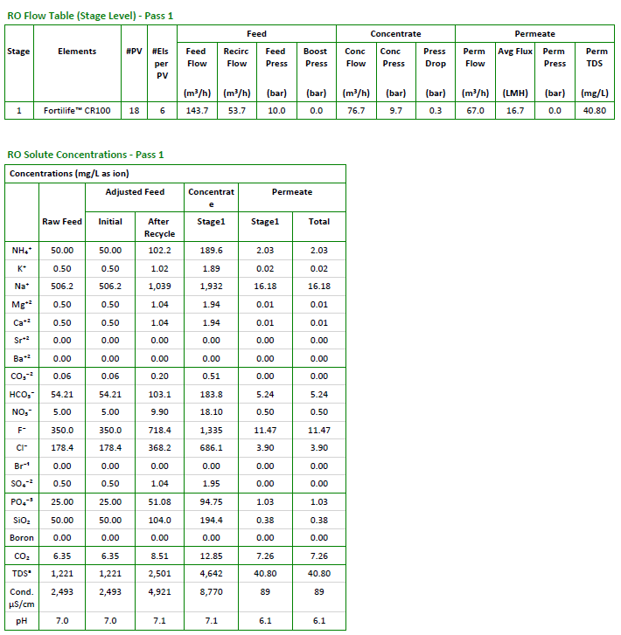
Case 4: ROi Projections - Mixed Influent CR100 at 75% Recovery

Slide 11
HFW+LSR Mixed Influent WW chemistry Case 5
S/N | Parameters | Units | HFW | LSR A2 | Combined Wastewater
1 | Flow | m3/h | 150.0 | 200.0 | 350.0
2 | pH | - |  | 7 - 9 | 7*
3 | Sodium | mg/ℓ | 750.00 | 262.3 | 471.3
4 | Potassium | mg/ℓ |  | 1.0 | 0.6
4 | Magnesium | mg/ℓ |  | 1.0 | 0.6
5 | Calcium | mg/ℓ |  | 1.0 | 0.6
6 | Nitrate | mg/ℓ |  | 10.0 | 5.7
6 | Carbonate | mg/ℓ |  | 12.0 | 6.8
7 | Bicarbonate | mg/ℓ |  | 108.3 | 61.9
7 | Chloride | mg/ℓ | 250.00 | 50.0 | 135.7
8 | Sulphate | mg/ℓ |  | 1.0 | 0.6
9 | Silica | mg/ℓ |  | 100.0 | 57.1
12 | TDS | mg/ℓ | 1000 |  | 428.6
13 | Fluoride | mg/ℓ | 500.0 | 200.0 | 328.6
14 | TSS | mg/ℓ | 1000.0 | 200.0 | 542.9
14 | NH4 | mg/ℓ |  | 100.0 | 57.1
15 | Phosphate | mg/ℓ | 50.0 |  | 21.4
*Assumed to be neutral Ph. This will be confirmed after collecting few samples
Notes:
210 m3/hr – LSR
190 M3/HR - HFW

Slide 12
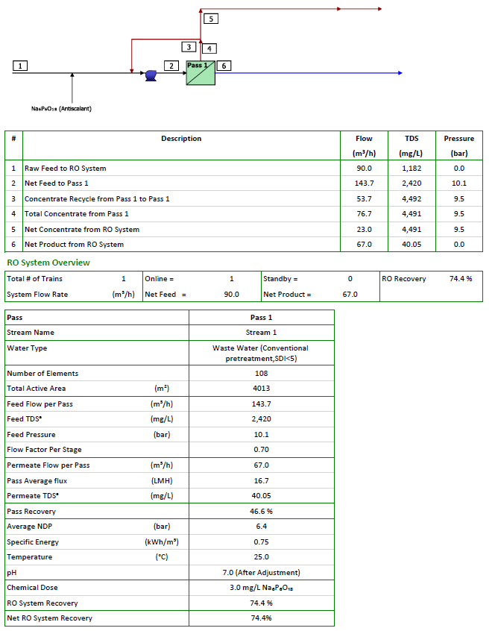
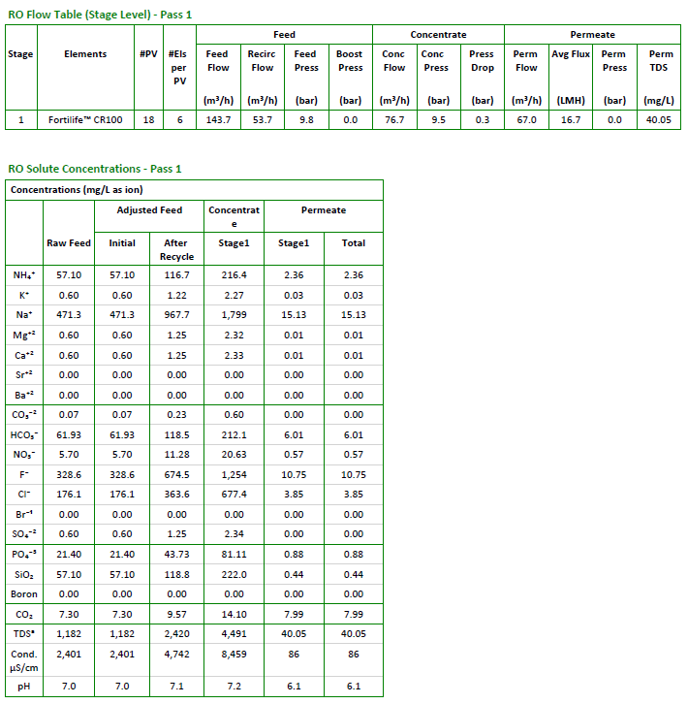
Case 5: ROi Projections - Mixed Influent CR100 at 75% Recovery

Slide 13
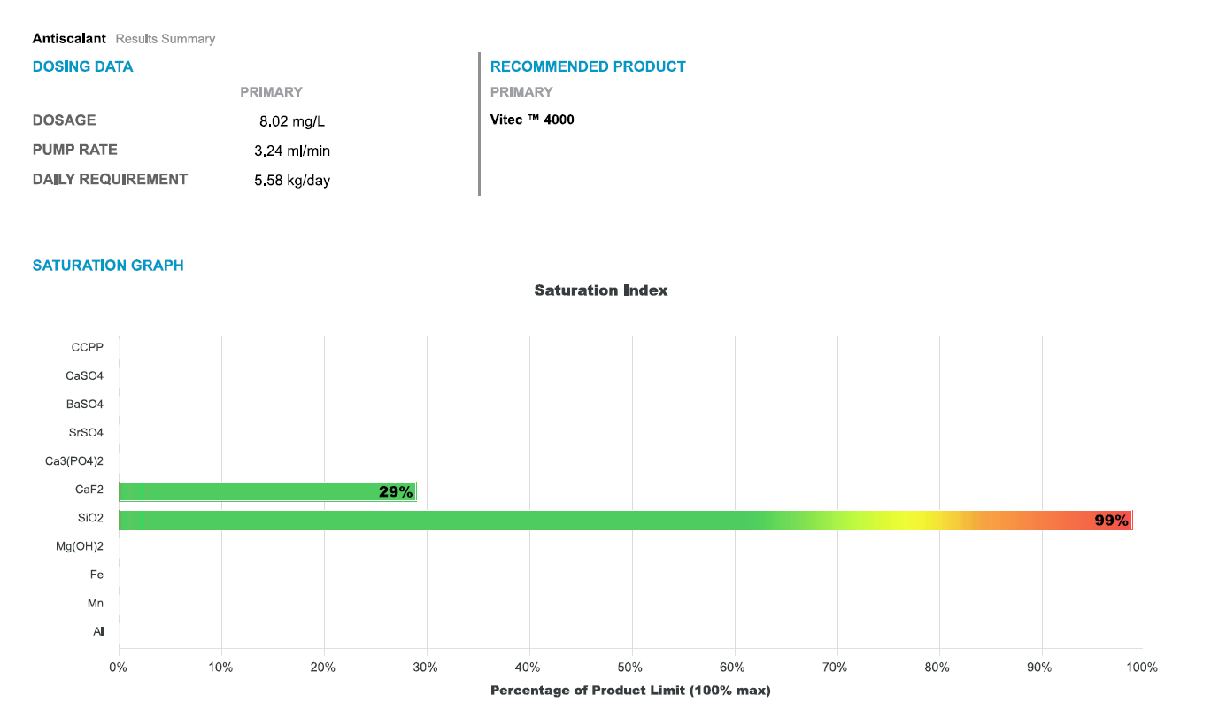
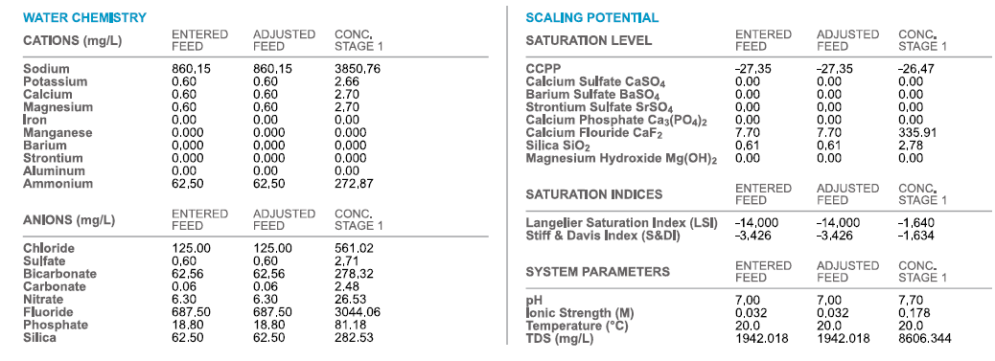
Antiscalant projections Vitec 4000
Maximum recovery -75%

Slide 14
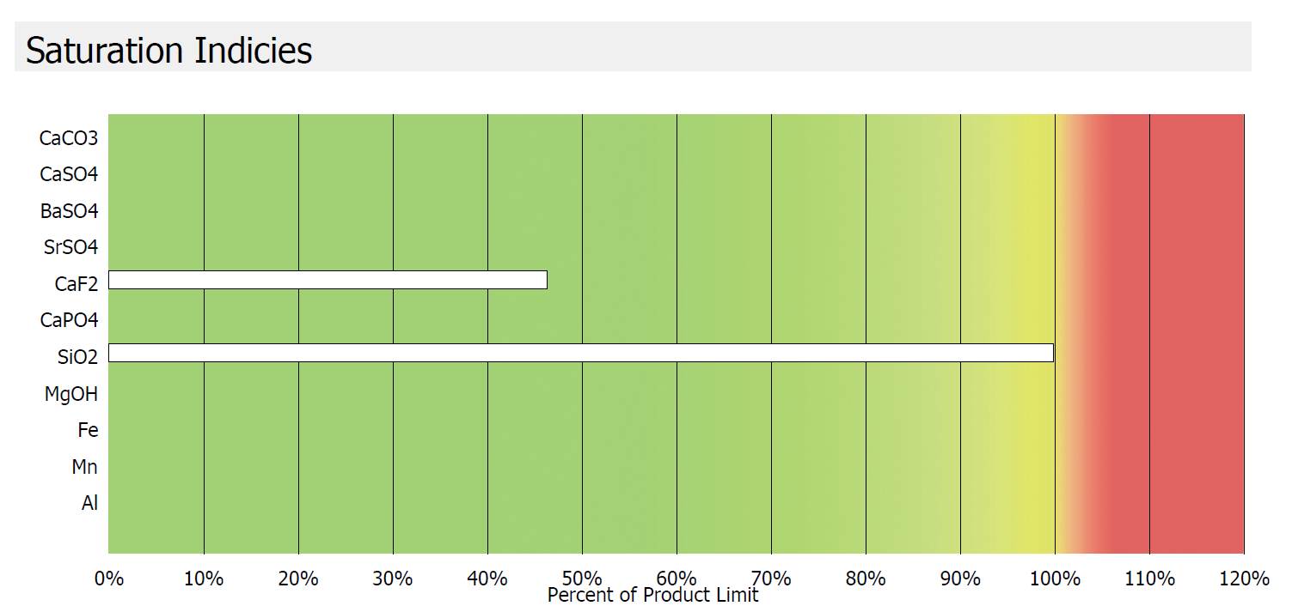
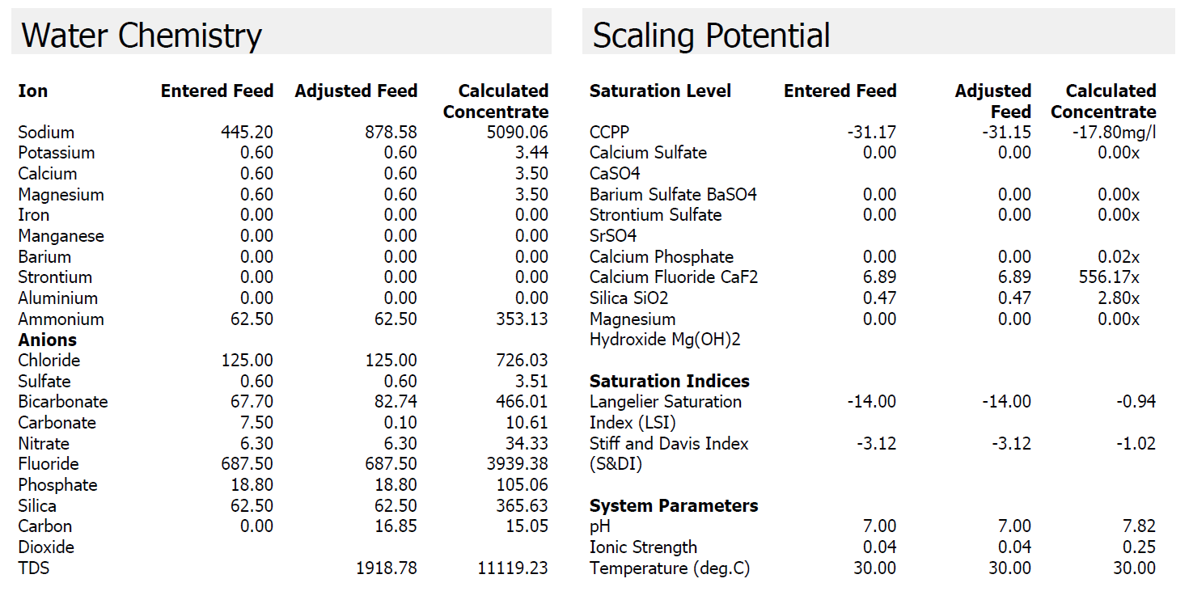
Antiscalant projections Gradiant Smart+ chemicals
Maximum recovery -83%

Slide 15
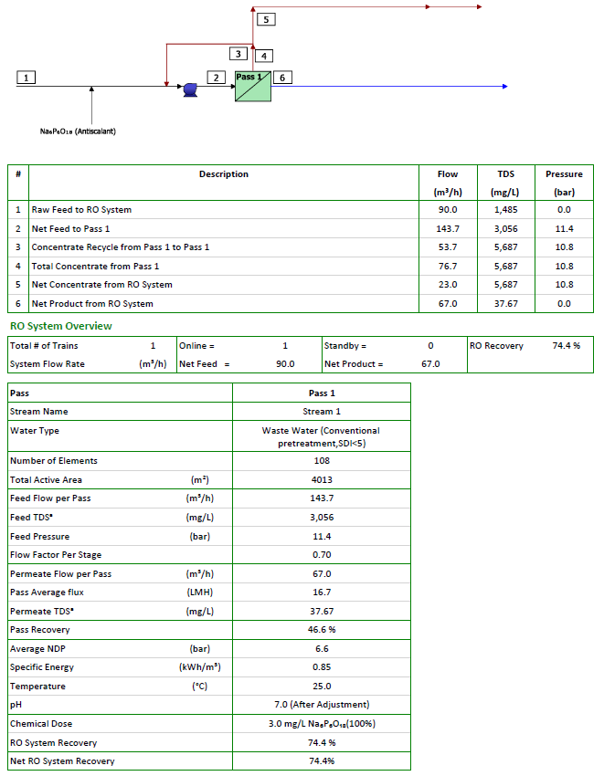
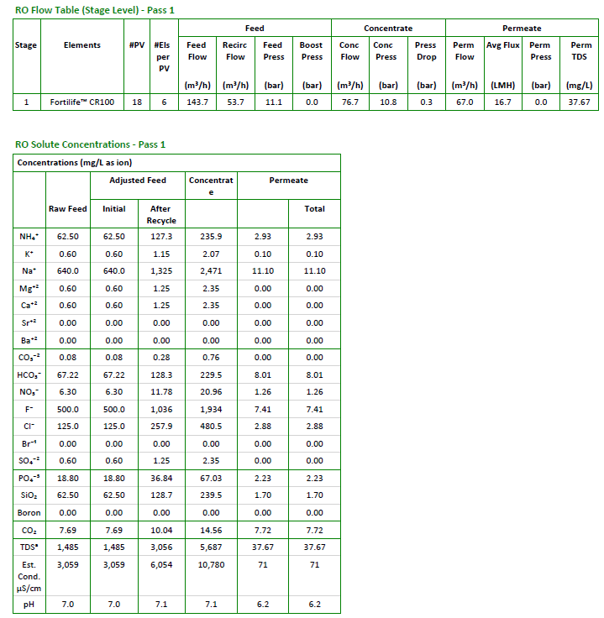
Case 1: ROi Projections - Mixed Influent CR100 and 75% recovery

Slide 16
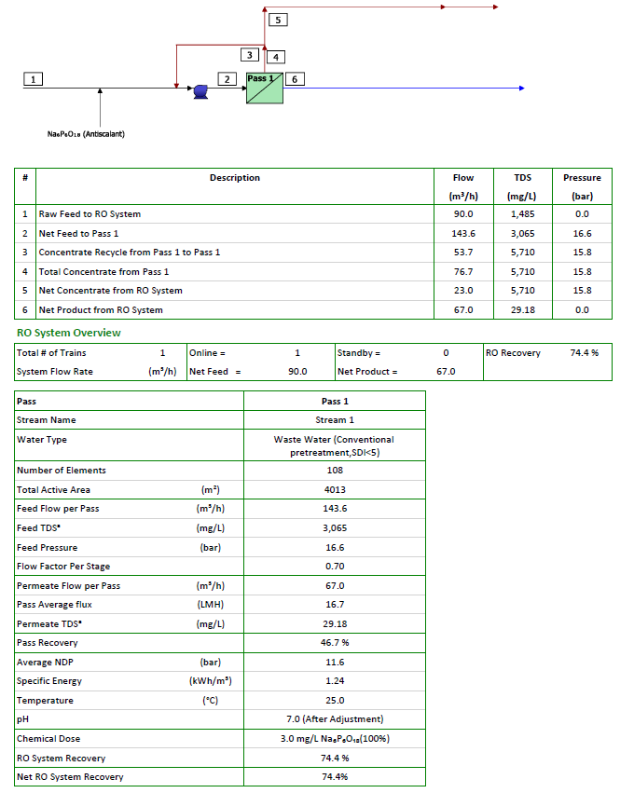
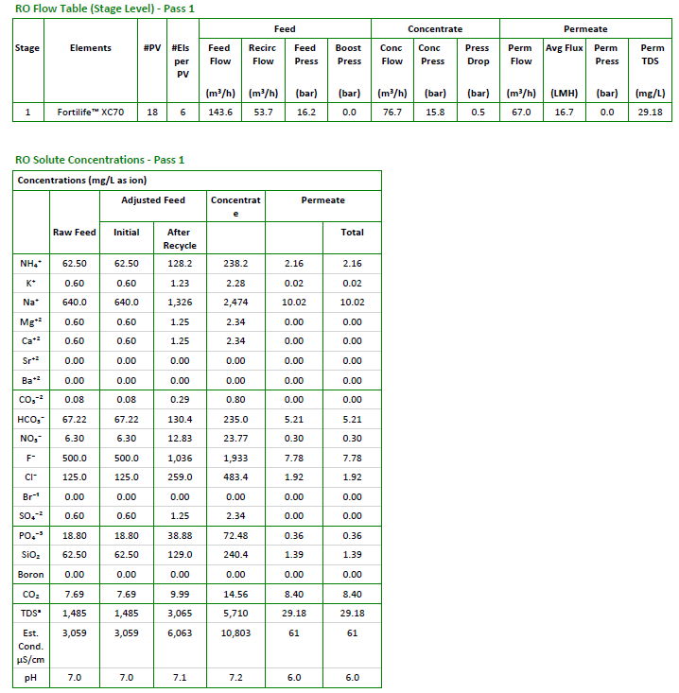
Case 1: ROi Projections - Mixed Influent XC70 and 75% recovery

Slide 17
Summary
HFW Flow, m3/hr | LSR Flow, m3/hr | HFW, Fluoride mg/l | Mixed stream Fluoride, mg/l | Permeate Fluoride, mg/l | ROi Recovery, %
150 | 250 | 1500 | 687.5 | 10.4 | 75%
150 | 250 | 500 | 312.5 | 10.2 | 75%
190 | 210 | 500 | 352.5 | 4.9 | 75%
150 | 150 | 500 | 350 | 11.4 | 75%
150 | 200 | 500 | 328.6 | 10.7 | 75%
150 | 250 | 1000 | 500 | 7.8 | 75%
Highlighted data for the SW membranes

